Slide 1
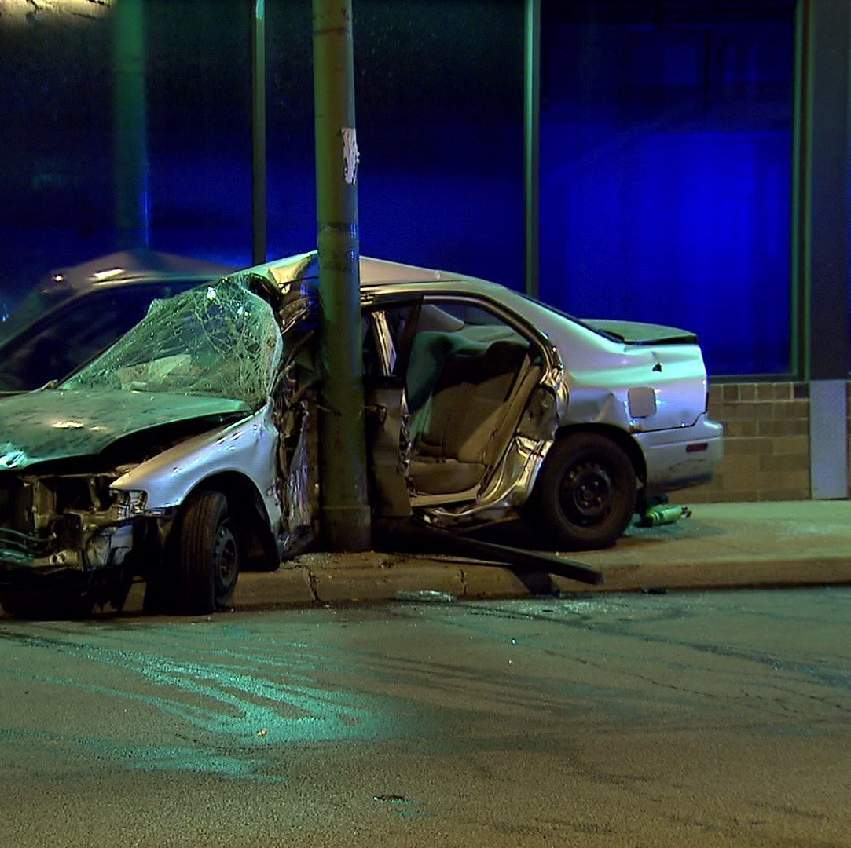
Traffic Crashes in Chicago
DAB - 103
Section - 002
Group - 005
Arpan Miteshkumar Shah – 813493
Jay Mukundbhai Shah - 802101
Mankumar Niteshbhai Sheta - 813528
Meet Jageshbhai Shah - 797050
Harshil Rajeshkumar Patel - 801869

Slide 2
Background/ Motivation
Current days, numbers of car crashes occurred on street and its gradually increase day by day.
So, there are number of reasons responsible for this accidents. Such as weather conditions, device condition, speed limit.

Slide 3
Problem statement
The statement includes in which climatic conditions the maximum number of accidents occurred. It also shows the situations and police charges of accidents.
In our project the insurance companies will play the role of audience.
The insurance companies needs the exact data for commencing the plans according to the areas where the accidents are mostly occurred.

Slide 4
Project proposal
We will analyse the maximum number of crashes occurred at what time and date and the death ratio which can be accessed by CPD as well as insurance companies from anywhere and everywhere.
In our project the role of targeted audience is played by insurance companies.
How insurance companies formulate their accident polices according to given data?

Slide 5
Analysis Questions
This analysis questions are based on some conditions which are responsible for crashes in city of Chicago.
What are the areas where maximum number of accidents occurred like North, South, East, or West?
In which weather condition, lighting conditions, and road conditions most car crashes are commenced?
Crashes based on the police charges like Crashes charges are over $1500 or below $500 ?

Slide 6
Dataset Description
The analysis will be based on Chicago car crash dataset obtained from https://data.cityofchicago.org/Transportation/Traffic-Crashes-Crashes/85ca-t3if/data
As the dataset states, the streets of Chicago has come across car crashes from the year 2016 to 2022. It shows the types of crashes and the injury rate. The reasons behind the crashes can vary from climatic conditions to over speeding.
Most of the crashes are reported to the CPD which is Chicago Police Department. The dataset only includes inter city traffic crashes and not including interstate highway, free ramps and the roads which are above the city boundary.

Slide 7
EDA(Exploratory Data Analysis)
In this we define the column names.
We find the number of Null value in columns.
Shape of the dataset
Use describe function to find count, mean, and std of each column.

Slide 8
Data Cleaning & Transformation
Data Cleaning:
We removed unwanted columns from data
Null values are also removed by us
After that, We removed some particular values from particular column like, from LIGHTING_CONDITIONS we removed value ‘Unknown’ , from REPORT_TYPE we removed value ‘NAN’.
Data Transformation:
In data transformation we made only one change.
We created new column Crash_Year from Crash_Date which is provided in data.

Slide 9
Data Cleaning & Transformation

Slide 10

Data Analysis Identify key patterns and insights

Slide 11
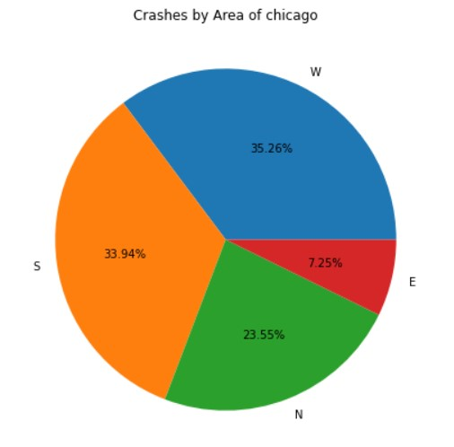
What are the areas where maximum number of accidents occurred like in North, South, East, or West?
Data Analysis based on Analysis Questions
From the given pie chart, we can see that the pie chart providing the information about crashes occurred by area.
Most accidents occurred in west area of Chicago from year 2016 to 2022 which is 35.26%.
After that, Accidents occurred in south and north area are 33.94% and 23.55% respectively.
Least number of accidents occurred in east area of Chicago which is only 7.25%.

Slide 12
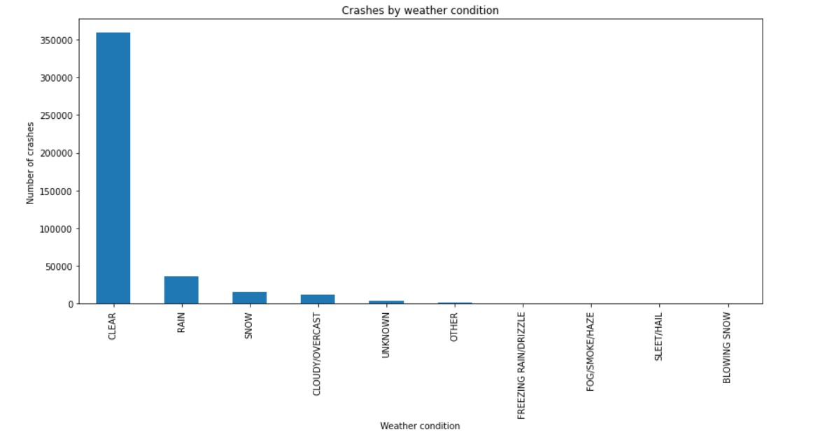
In which weather condition, lighting conditions, and road conditions most car crashes are commenced?
I ) weather condition:
Another analysis is based on weather conditions.
From we can see that among all conditions maximum number of crashes are happened in clear weather which is around 350,000 between 2016 and 2022.
After that nearly 50,000 accidents occurred during raining and nearly 25,000 crashes occurred during snow and cloudy weather.
From this bar graph we can see that during freezing rain, fog, and blowing snow there is 0 crashes occurred.

Slide 13
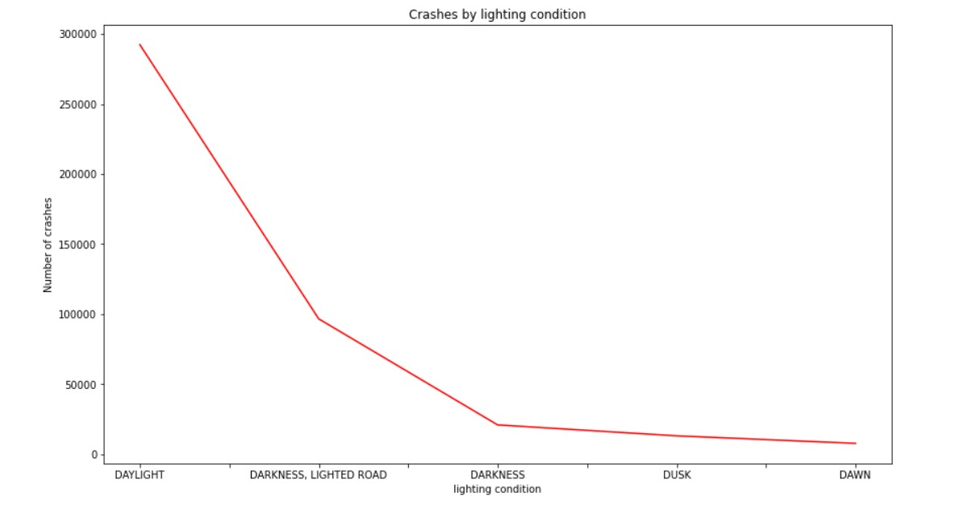
II ) lighting condition:
Another analysis is based on lighting conditions, and we choose line graph for that.
During day nearly 290,000 accidents occurred in Chicago from year 2016 to 2022 which is most among all lighting conditions.
We can see that there is sharp drop in accidents by lighting conditions. Around 100,000 crashes occurred in night, but the road has the lights and still it happened.
Another is darkness, Road without light and accidents occurred is below 25,000.
Another conditions are dusk and dawn which is nearly 5000 for both.

Slide 14
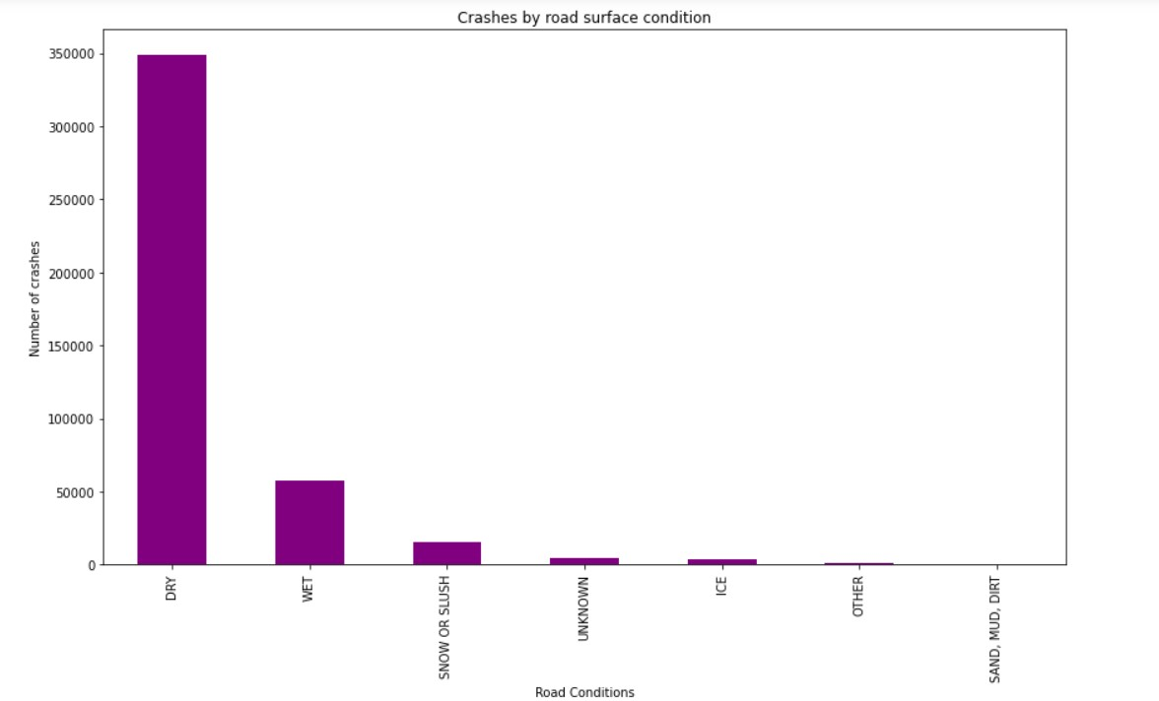
III ) Road condition:
Another analysis is based on road conditions and we choose bar graph for that.
The graph shows that maximum number of accidents occurred on dry road which is around 350,000.
On wet road slightly more than 50,000 crashes occurred in city of Chicago from year 2016 to 2022.
After that, another road condition is road with snow or slush due to this below 25,000 crashes occurred.
Remaining 4 conditions are unknown, ice, other, and sand . Due to this around 5000 crashes occurred by unknown and ice and nearly 1000 by other and 0 by sand.

Slide 15
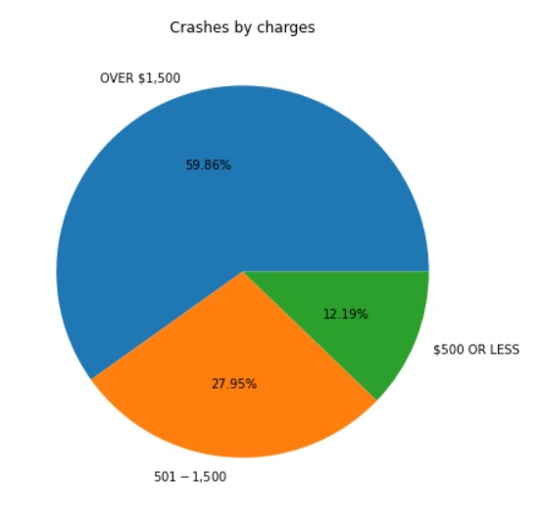
Crashes based on the police charges like Crashes charges are over $1500 or below $500 ?
From the given pie chart, we can see that the pie chart providing the information about crashes by charges.
Most of the crashes are charged over $1500 by police in Chicago which is 59.86%.
After that, 27.95% of accidents are charged between $501 and $1500 from year 2016 to 2022.
Only 12.19% of crashes are charged $500 or Less by police of Chicago.

Slide 16
Conclusions & Recommendations
Conclusions:
Based on analysis question, Our conclusion is that most of the crashes occurred in west side of the Chicago.
Most of the accidents are charged above $1500 by police of Chicago.
In clear weather and during day and on dry road the number of crashes occurred most among all conditions.
Recommendations:
It can be useful for the insurance company to notice that maximum amount of accident is having damage of more than $1500.
It can also be useful for Government of Chicago to see that maximum accident occurs in West Chicago so they might take some steps.

Slide 17
References
1) Bar & Line chart
https://dfrieds.com/data-visualizations/bar-plot-python-pandas.html
2) Remove particular value from column
https://stackoverflow.com/questions/18172851/deleting-dataframe-row-in-pandas-based-on-column-value
3) Remove null value from data
https://www.digitalocean.com/community/tutorials/pandas-dropna-drop-null-na-values-from-dataframe
4) Remove column from data
https://www.educative.io/answers/how-to-delete-a-column-in-pandas
5) Create pie chart
https://www.youtube.com/watch?v=F-X82zhIfBo&list=PLZoTAELRMXVPzj1D0i_6ajJ6gyD22b3jh&index=3
6) Create crash year from crash date
https://www.interviewqs.com/ddi-code-snippets/extract-month-year-pandas

Slide 18


